Slide 1

Loan Approval Forecasting using Machine Learning
Supervisor
Dr. A. MANIKANDAN M.E, Ph.D., Associate Professor Department of CSE VISTAS, Chennai

Slide 2
Abstract
In recent years, the financial industry has experienced a significant transformation with the introduction of automated decision-making systems powered by Machine Learning (ML). One of the critical applications of ML in the financial sector is loan approval forecasting, where traditional manual decision-making processes are augmented or replaced by data-driven models. The goal of this project is to predict loan approval decisions based on a range of applicant features, including personal information such as income, credit score, employment history, and loan characteristics, to enhance the efficiency and accuracy of loan approval processes. The project utilizes a dataset containing historical loan application data, where each entry represents an applicant’s personal and financial details along with the loan approval outcome (approved or rejected). The primary objective is to develop a robust and accurate machine learning model capable of forecasting loan approval decisions in real-time, minimizing human error and subjectivity in the decision-making process. This involves several stages, including data preprocessing, feature selection, and model training. We employed various supervised machine learning algorithms, including Logistic Regression, Decision Trees, Random Forests, and Support Vector Machines (SVM), to build predictive models. Data preprocessing tasks involved handling missing values, normalizing numerical variables, and encoding categorical features to prepare the dataset for model training. The dataset was split into training and testing sets to assess the model's performance. Model performance was evaluated using standard classification metrics such as accuracy, precision, recall, F1-score, and ROC-AUC. Cross-validation techniques were employed to avoid overfitting and to ensure that the models generalize well to unseen data. After training and tuning the models, we compared their performances to determine the most effective approach for predicting loan approval. The findings indicate that machine learning models, particularly Random Forest and Support Vector Machines, achieved high accuracy and predictive power in forecasting loan approval outcomes. These results demonstrate the potential of ML models to automate and optimize decision-making in the financial sector, offering faster, more consistent, and unbiased loan approval decisions. Ultimately, the research concludes that Machine Learning offers a promising solution to enhance loan approval systems and provides a foundation for future exploration in areas such as credit scoring, fraud detection, and personalized loan offerings.

Slide 3
Abstract
In recent years, the financial industry has experienced a significant transformation with the introduction of automated decision-making systems powered by Machine Learning (ML). One of the critical applications of ML in the financial sector is loan approval forecasting, where traditional manual decision-making processes are augmented or replaced by data-driven models. The goal of this project is to predict loan approval decisions based on a range of applicant features, including personal information such as income, credit score, employment history, and loan characteristics, to enhance the efficiency and accuracy of loan approval processes. The project utilizes a dataset containing historical loan application data, where each entry represents an applicant’s personal and financial details along with the loan approval outcome (approved or rejected). The primary objective is to develop a robust and accurate machine learning model capable of forecasting loan approval decisions in real-time, minimizing human error and subjectivity in the decision-making process. This involves several stages, including data preprocessing, feature selection, and model training. We employed various supervised machine learning algorithms, including Logistic Regression, Decision Trees, Random Forests, and Support Vector Machines (SVM), to build predictive models. Data preprocessing tasks involved handling missing values, normalizing numerical variables, and encoding categorical features to prepare the dataset for model training. The dataset was split into training and testing sets to assess the model's performance. Model performance was evaluated using standard classification metrics such as accuracy, precision, recall, F1-score, and ROC-AUC. Cross-validation techniques were employed to avoid overfitting and to ensure that the models generalize well to unseen data. After training and tuning the models, we compared their performances to determine the most effective approach for predicting loan approval. The findings indicate that machine learning models, particularly Random Forest and Support Vector Machines, achieved high accuracy and predictive power in forecasting loan approval outcomes. These results demonstrate the potential of ML models to automate and optimize decision-making in the financial sector, offering faster, more consistent, and unbiased loan approval decisions. Ultimately, the research concludes that Machine Learning offers a promising solution to enhance loan approval systems and provides a foundation for future exploration in areas such as credit scoring, fraud detection, and personalized loan offerings.
3

Slide 4
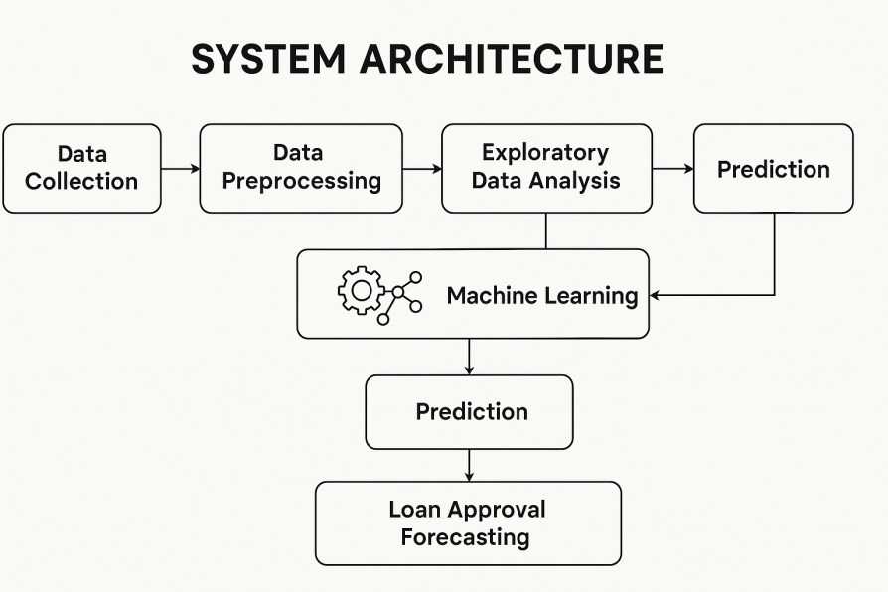
Block Diagram
4

Slide 5
Problem Inferred
Context & Motivation
Manual loan approval is time-consuming and prone to human bias.
Financial institutions face increasing demand for faster, more reliable approval decisions.
Inconsistent decision-making affects customer trust and institutional risk.
Core Problem
Can we automate and improve the accuracy of loan approval decisions?
Predict whether a loan should be approved or rejected based on historical data.
Why It's a Problem Worth Solving
Helps reduce loan default risk.
Increases operational efficiency and decision consiWstency.
Provides data-driven insights for fairer, faster processing.
Why Use Machine Learning?
ML can uncover complex patterns in applicant data.
Capable of learning from thousands of past applications.
Can predict outcomes more accurately than rule-based systems.

Slide 6
Objective
Primary Objective
Develop a machine learning model to predict whether a loan application should be approved or rejected.
Key Goals
Automate the loan approval process with high accuracy.
Minimize manual intervention and human error.
Provide real-time decision-making support to financial institutions.
Performance Objectives
Achieve high precision and recall to avoid false approvals or rejections.
Handle imbalanced datasets and missing data efficiently.
Ensure model interpretability and fairness in predictions.
Business Impact
Reduce loan default rates by identifying risky applications early.
Improve customer experience with faster approval times.
Support risk management and regulatory compliance through data-driven insights.

Slide 7
Scope

Slide 8
Proposed Work Outline

Slide 9
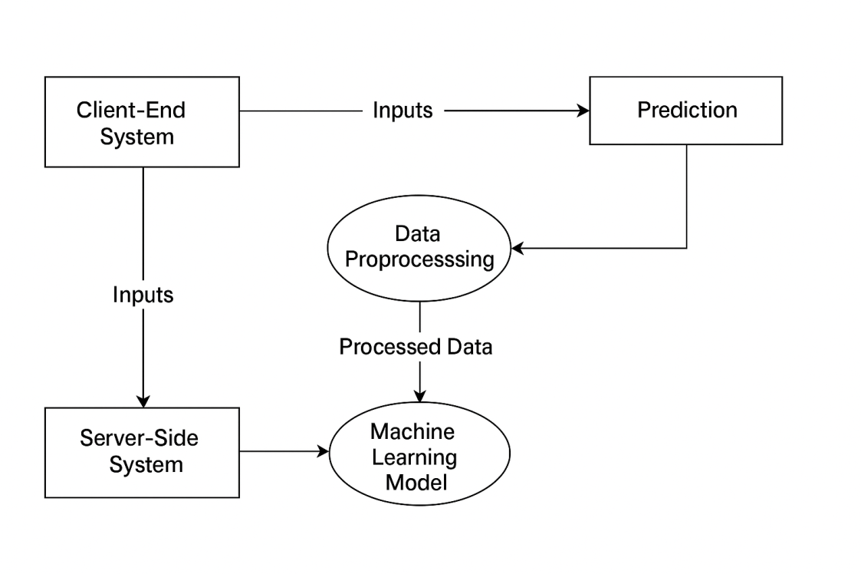
Overall Workflow Diagram

Slide 10
Feature Extraction
The process of identifying and selecting relevant attributes from raw data that can help the model make accurate predictions.
Converts real-world data into numerical inputs suitable for machine learning algorithms.
This helps in reducing noise and overfitting in the model creation.
Improves model accuracy and training speed.
Focuses the model on the most impactful variables.
Key Features Extracted
Age – Indicates the Age of the Loan Applicant.
Applicant Income – Indicates earning capacity.
Loan Amount – Determines the risk for the lender.
Cibil Score– Crucial indicator of creditworthiness.
Interest – Interest Percentage

Slide 11
Overall Processing Flow Diagram

Slide 12
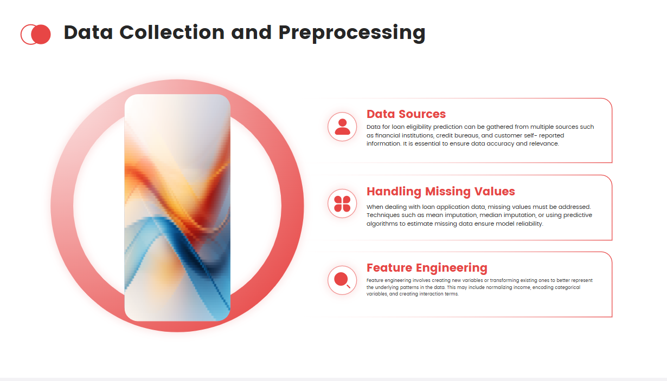
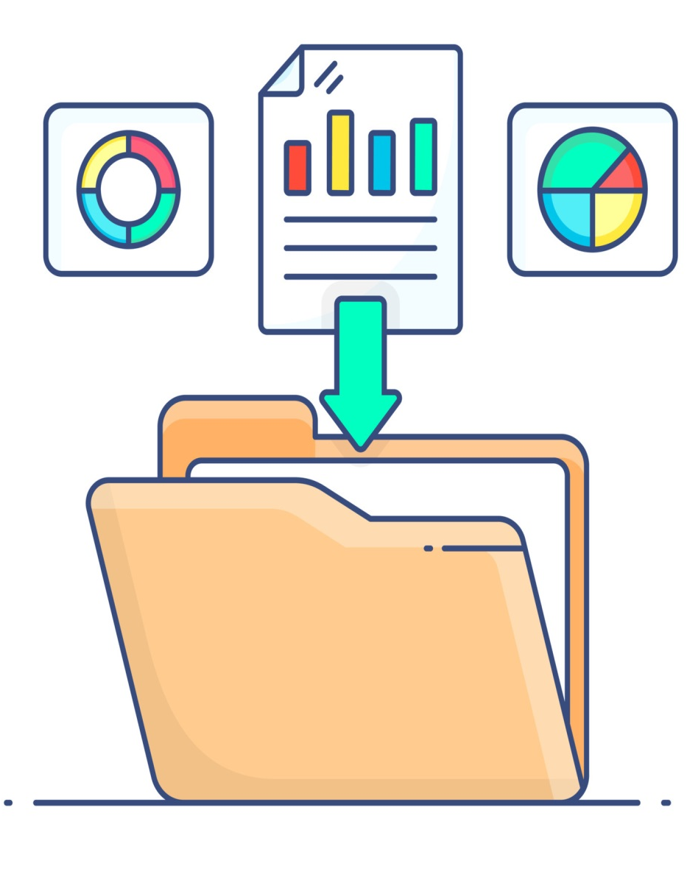

Slide 13
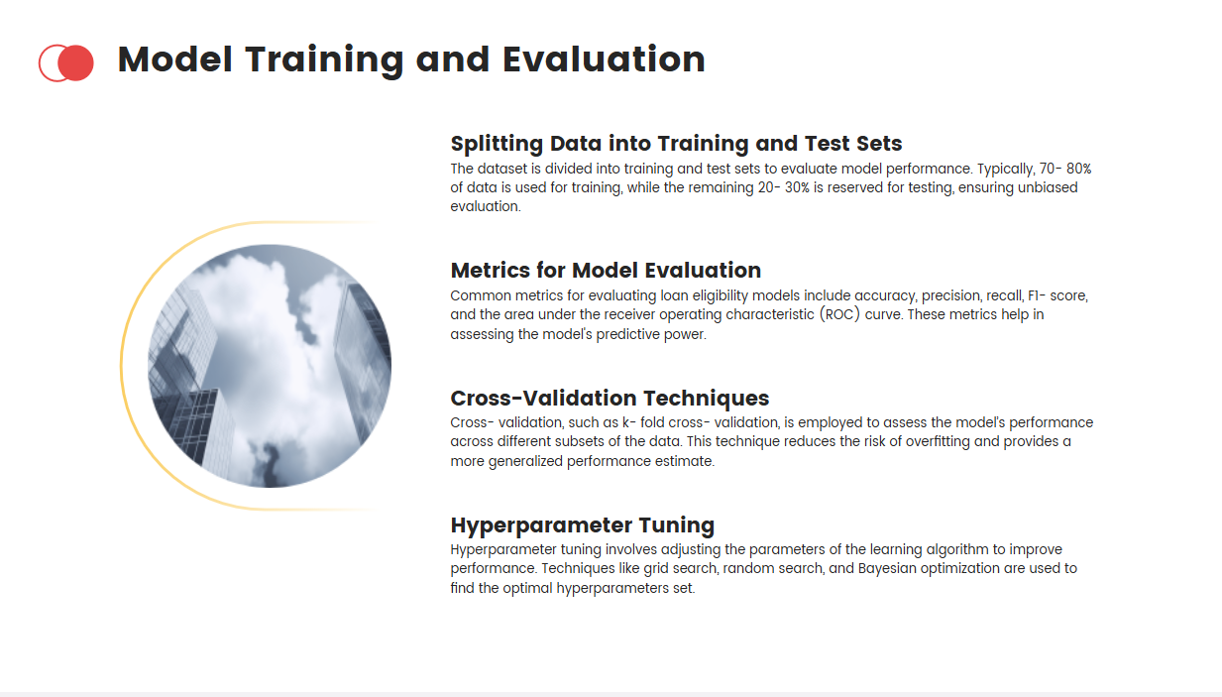
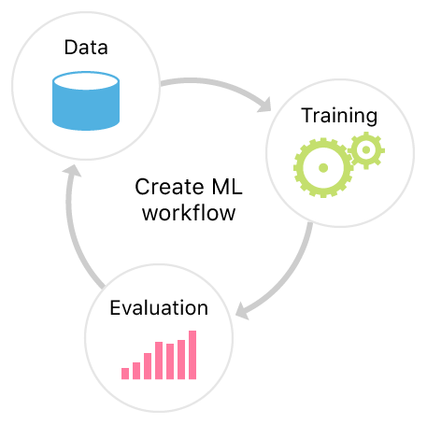

Slide 14
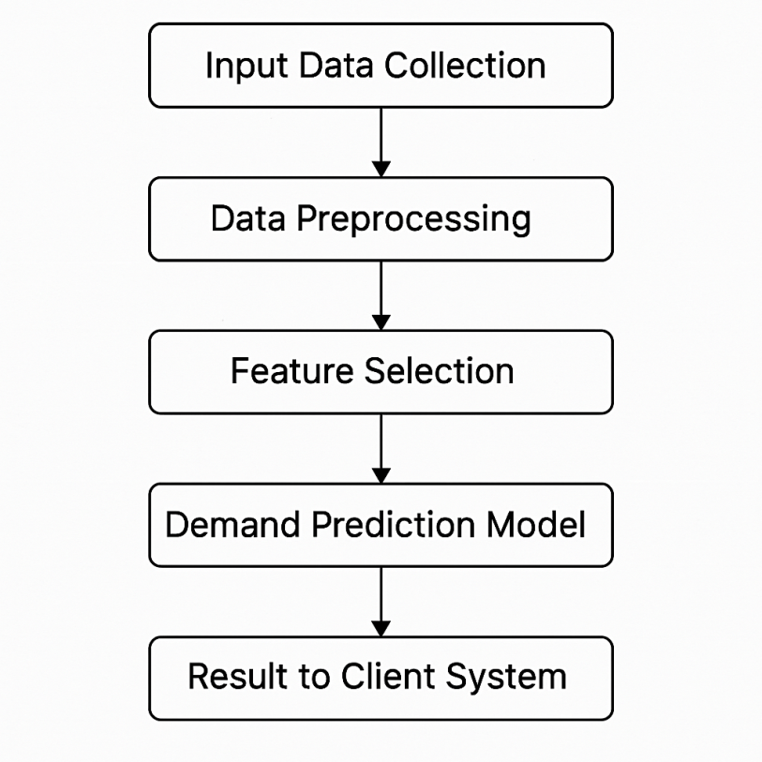
Module Flow Diagram

Slide 15

Minimum Hardware Requirements
Processor : Intel i3 or equivalent.
Storage : 256 GB HDD or SSD.
Monitor : 15 inch VGA Color.
Mouse : Logitech Mouse.
Ram : 4 GB
Keyboard : Standard Keyboard
GPU : Integrated GPU
Internet : Basic internet connection

Slide 16


Software Requirements
Python
Django (Web Framework)
Libraries Used
Scikit-learn
Pickle
Numpy
Pandas

Slide 17
The primary contribution of this paper:

Slide 18
Conclusion & Future Enhancement

Slide 19
REFERENCES

Slide 20

THANK YOU
Dr. A. Manikandan (Supervisor)
Mrs. R. Kalpana (Supervisor)

